Slide 1
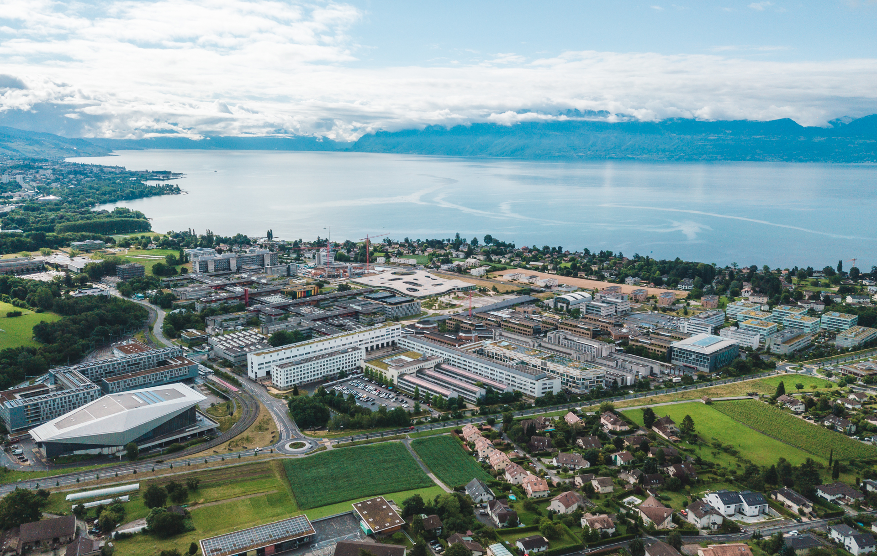
Implementing countermeasures for attacks on Supersingular Isogeny Diffie-Hellman (SIDH)
Malo RANZETTI
Semester Project Presentation
Ecole Polytechnique Fédérale de Lausanne
June 2023

Slide 2
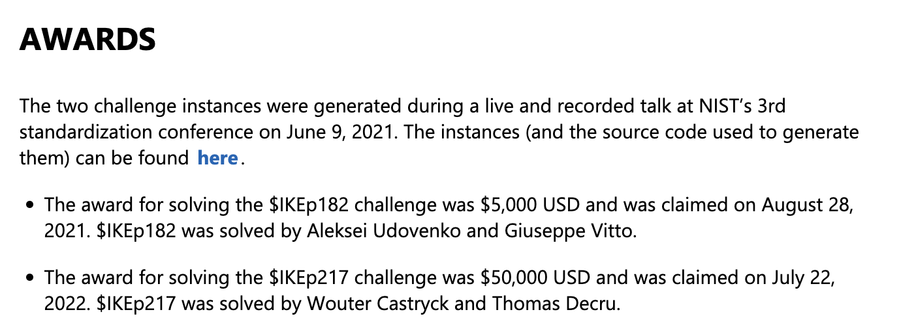
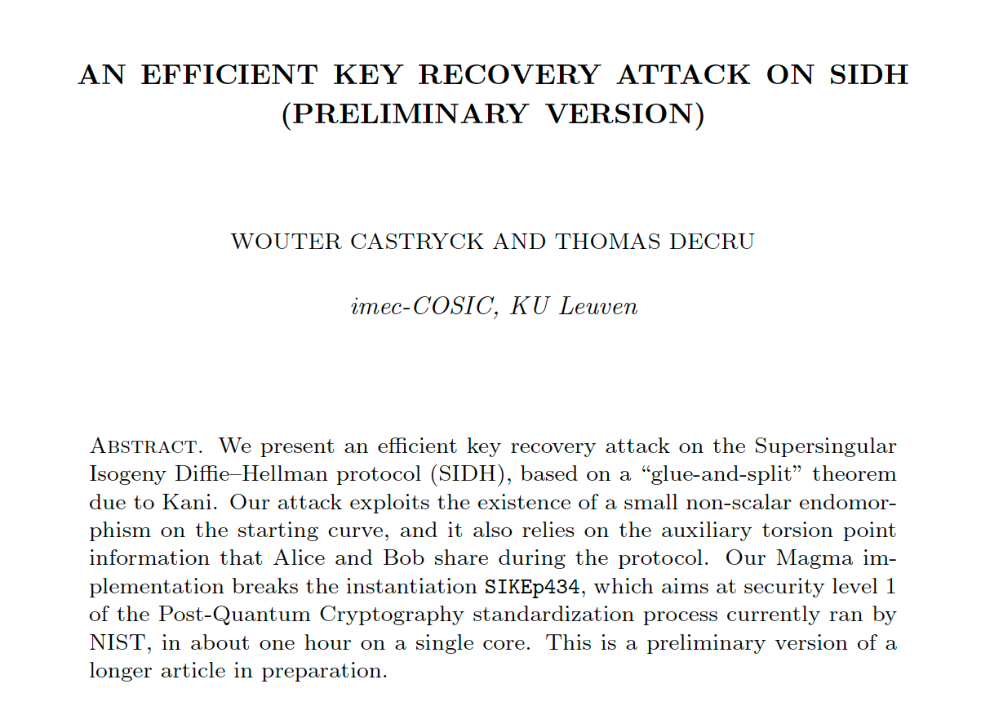
Supersingular elliptic curves, isogenies, post-quantum cryptography: modern and rapidly evolving field
Introduction to Supersingular Isogeny Diffie-Hellman (SIDH) key exchange in 2011 (part of SIKE standard)
Discovery of a polynomial time attack against SIDH in 2022 by Castryck and Decru
Introduction of the M-SIDH scheme as a countermeasure
Project objective: Implementation and evaluation of M-SIDH in terms of performance
Fig.1: Microsoft $IKE challenge
Fig.2: Paper by Castryck and Decru

Slide 3
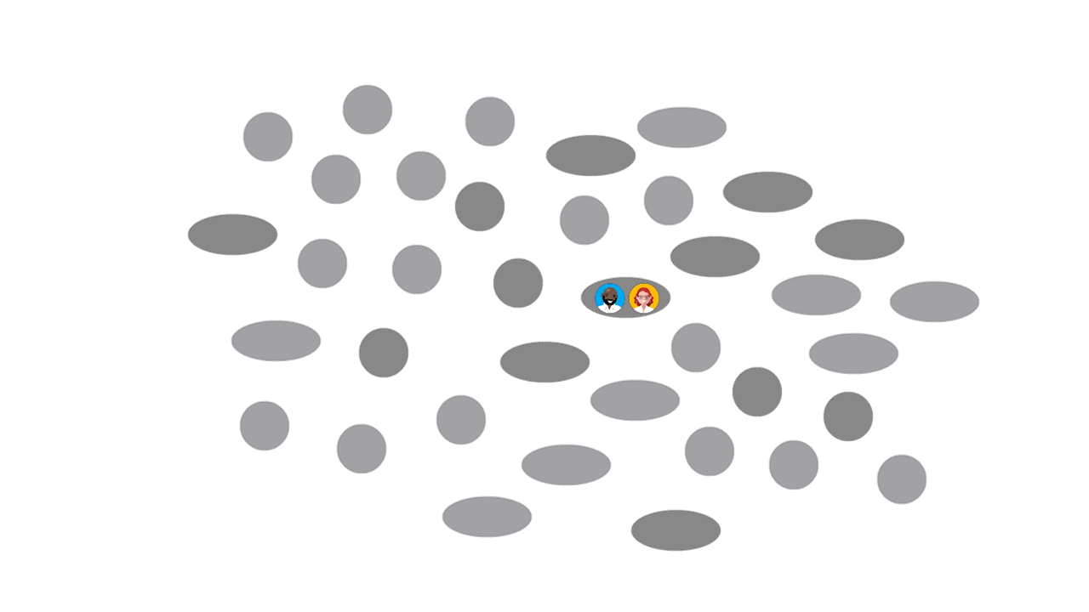
Supersingular Isogeny Diffie-Hellman
Basic idea:
Use isogenies between curves as the trapdoor function in a Diffie-Hellman scheme
Fig.3: Animation illustrating an isogeny based DH [Microsoft]

Slide 4
Supersingular Isogeny Diffie-Hellman
E_{A}
E_{B}
ϕ_{A}
Standard DH layout with:
Starting curve E₀
Secret isogenies ϕ_{A} and ϕ_{B}
Resulting curves E_{AB} = E_{BA} have the same j-invariant
E₀
Transmission
j(E_{AB}) = j(E_{BA})
ϕ_{B}
E_{B}
E_{A}

Slide 5
Supersingular Isogeny Diffie-Hellman
E_{A}
E_{B}
ϕ_{A}
Standard DH layout with:
Starting curve E₀
Secret isogenies ϕ_{A} and ϕ_{B}
Resulting curves E_{AB} = E_{BA} have the same j-invariant
Problem: Isogenies on supersingular curves are not commutative
E₀
Transmission
j(E_{AB}) ≠ j(E_{BA})
ϕ_{B}
E_{B}
E_{A}

Slide 6
Supersingular Isogeny Diffie-Hellman
(E_{A}, ϕ_{A}(P_{B}), ϕ_{A}(Q_{B}))
E_{B}
ϕ_{A}
ϕ_{A}’
Using ϕ_{B}(P_{A}), ϕ_{B}(Q_{A})
Making isogenies commutative:
We need to fix the kernel of the isogenies, so we need to transmit the images of the torsion points.
(E₀, P_{A}, Q_{A}, P_{B},Q_{B})
j(E_{AB}) = j(E_{BA})
Transmission
ϕ_{B}
ϕ_{B}’
Using ϕ_{A}(P_{B}), ϕ_{A}(Q_{B})
(E_{B}, ϕ_{B}(P_{A}), ϕ_{B}(Q_{A}))
E_{A}

Slide 7
Castryck & Decru Attack
(E_{A}, ϕ_{A}(P_{B}), ϕ_{A}(Q_{B}))
E_{B}
ϕ_{A}
ϕ_{A}’
Using ϕ_{B}(P_{A}), ϕ_{B}(Q_{A})
Attack is based on:
Knowledge of isogeny degrees
Knowledge of the images of the torsion points
(E₀, P_{A}, Q_{A}, P_{B},Q_{B})
j(E_{AB}) = j(E_{BA})
Transmission
ϕ_{B}
ϕ_{B}’
Using ϕ_{A}(P_{B}), ϕ_{A}(Q_{B})
(E_{B}, ϕ_{B}(P_{A}), ϕ_{B}(Q_{A}))
E_{A}

Slide 8
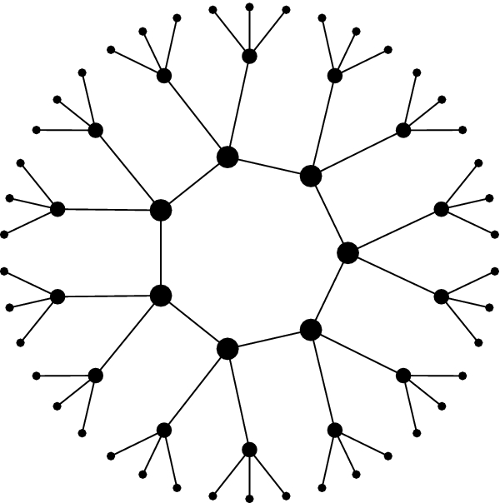
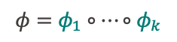
Castryck & Decru Attack
Isogeny ɸ of degree 3^{k}: E → E’
Isogeny ɸ_{i} of degree 3: E_{i} → E_{i+1}
$$φ=φ_{1}∘…∘φ_{k}$$
An isogeny of degree n has
n+1 possible co-domains
High level idea:
Decompose isogeny in prime steps
Use Kani’s theorem to construct an efficient Oracle
Use Oracle to find correct isogeny for each step

Slide 9
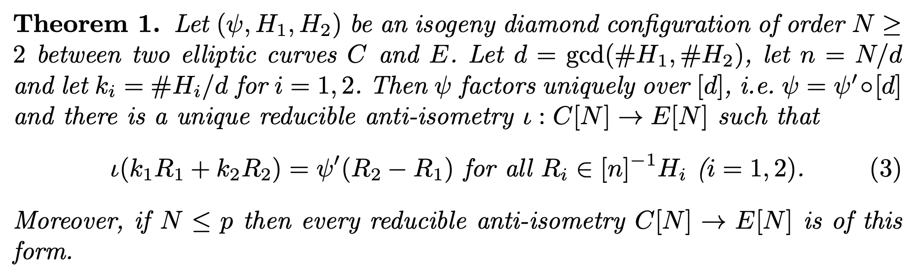
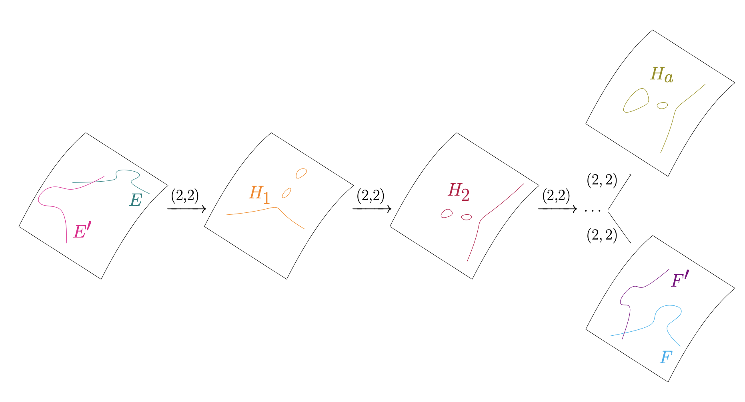
Countermeasures
Kani’s theorem:
Fig.4: Decision strategy based on Kani’s reducibility criterion

Slide 10
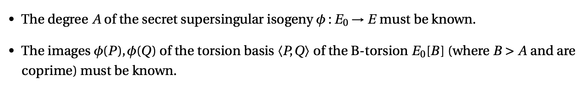
Countermeasures
Kani’s theorem:
Option 1: Mask the isogeny degree (MD-SIDH)
Option 2: Mask the images of the torsions points (M-SIDH)
M-SIDH has smaller key sizes and parameters for the same level of security as MD-SIDH

Slide 11
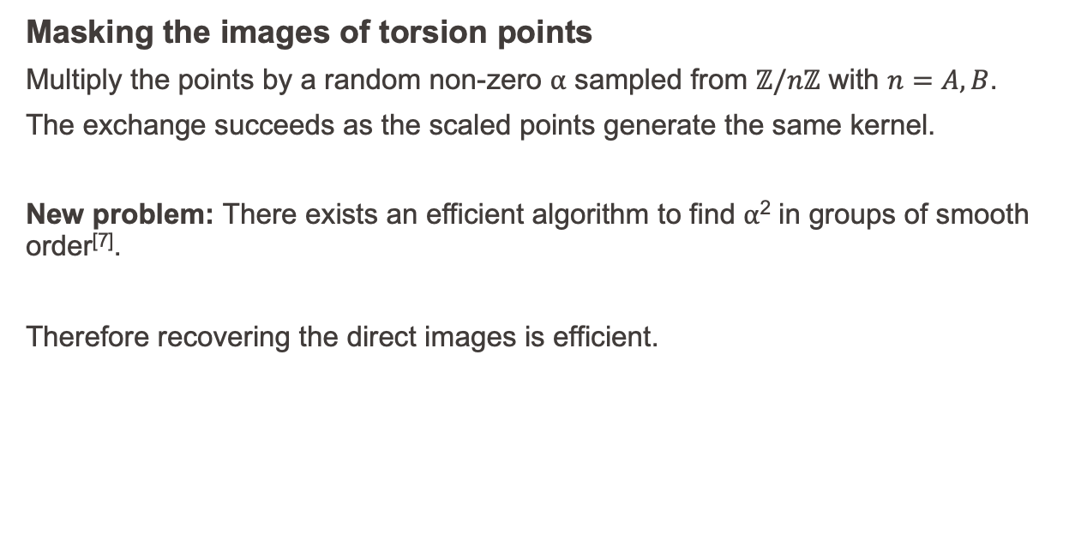
Modifications in M-SIDH
Masking the images of torsion points
Multiply the points by a random non-zero ⍺ sampled from $ℤ/nℤ$ with $n=A, B$.
The exchange succeeds as the scaled points generate the same kernel.
New problem: There exists an efficient algorithm to find ⍺² in groups of smooth order^{[7]}.
Therefore recovering the direct images is efficient.

Slide 12
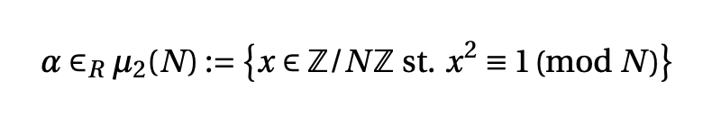
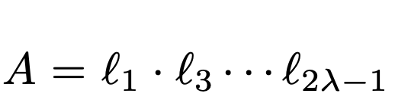
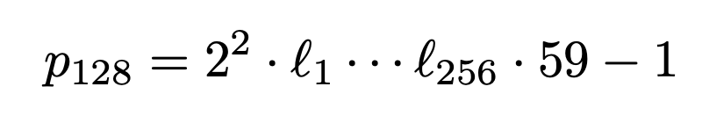
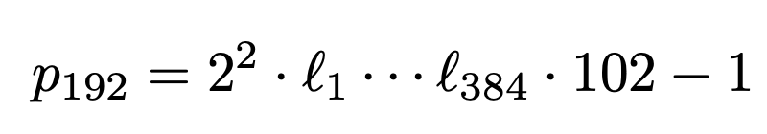
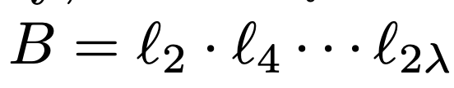
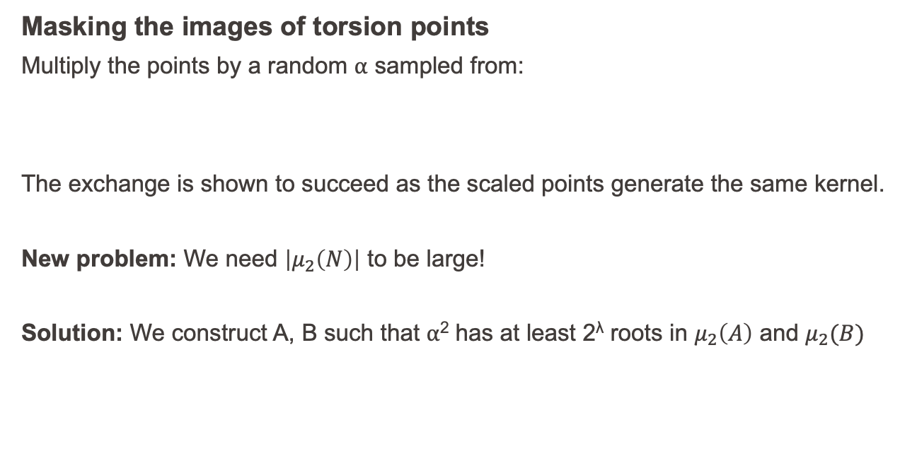
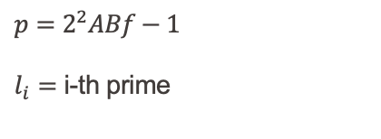
Modifications in M-SIDH
Masking the images of torsion points
Multiply the points by a random ⍺ sampled from:
The exchange is shown to succeed as the scaled points generate the same kernel.
New problem: We need $\left|μ_{2}\left(N\right)\right|$ to be large!
Solution: We construct A, B such that ⍺² has at least 2^{λ} roots in $μ_{2}\left(A\right)$ and $μ_{2}(B)$
$p=2^{2}ABf−1$
$l_{i}=$ i-th prime

Slide 13
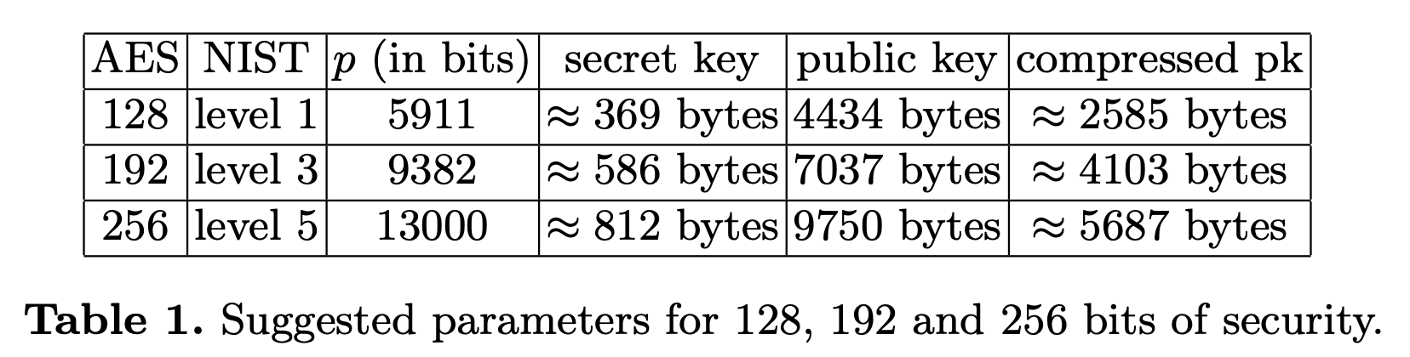
Modifications in M-SIDH
[8]

Slide 14
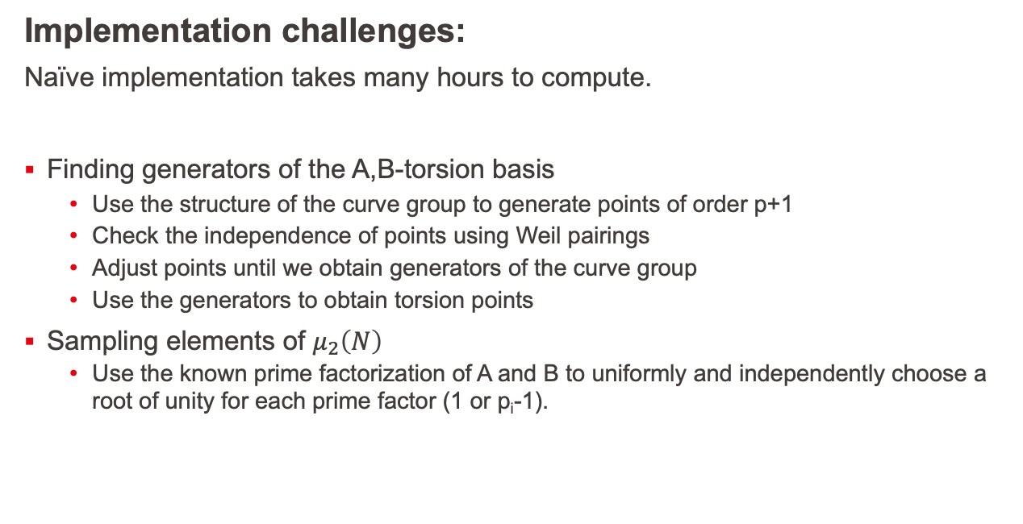
Implementation of M-SIDH
Implementation challenges:
Naïve implementation takes many hours to compute.
Finding generators of the A,B-torsion basis
Use the structure of the curve group to generate points of order p+1
Check the independence of points using Weil pairings
Adjust points until we obtain generators of the curve group
Use the generators to obtain torsion points
Sampling elements of $μ_{2}\left(N\right)$
Use the known prime factorization of A and B to uniformly and independently choose a root of unity for each prime factor (1 or p_{i}-1).

Slide 15
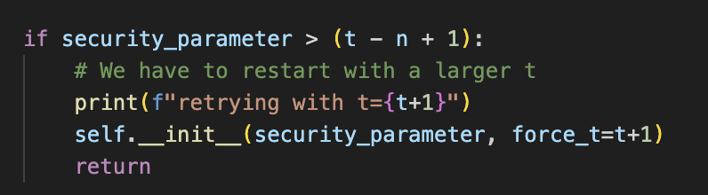
Implementation of M-SIDH
Bugs found along the way:
Some bugs compromised the security and efficiency
Efficiency problem with Sagemath
Proofs turned off to prevent is_prime computation on large p
The velusqrt algorithm seems to have efficiency problem (“naïve” Vélu is faster even for large n > 3000)
Factored isogeny did not leverage velusqrt (arguably lucky)
Factored isogeny recomputes order of kernel point at every step
Slight correction to proposed M-SIDH algorithm
“We then check the value t − n + 1 described in subsection 4.1. If λ < t − n + 1, we restart with a larger t”

Slide 16
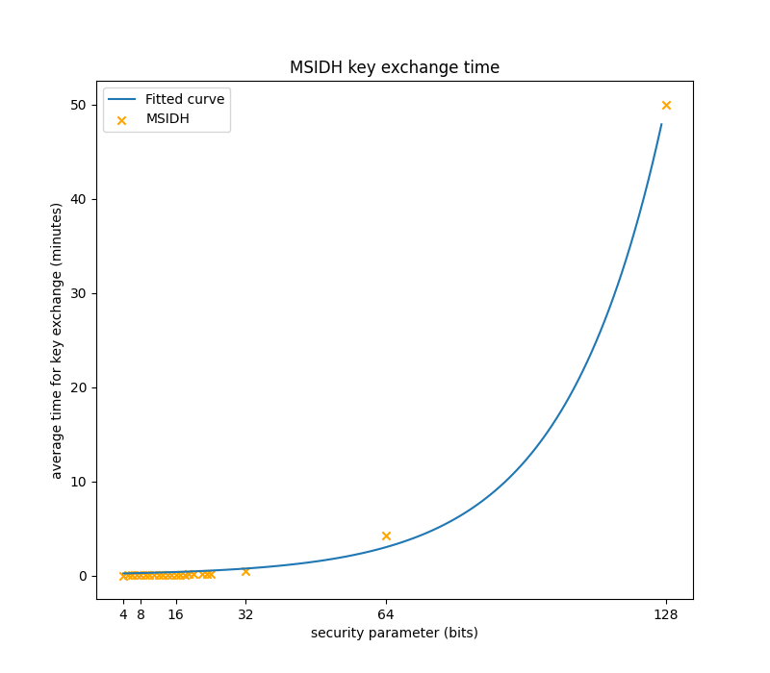
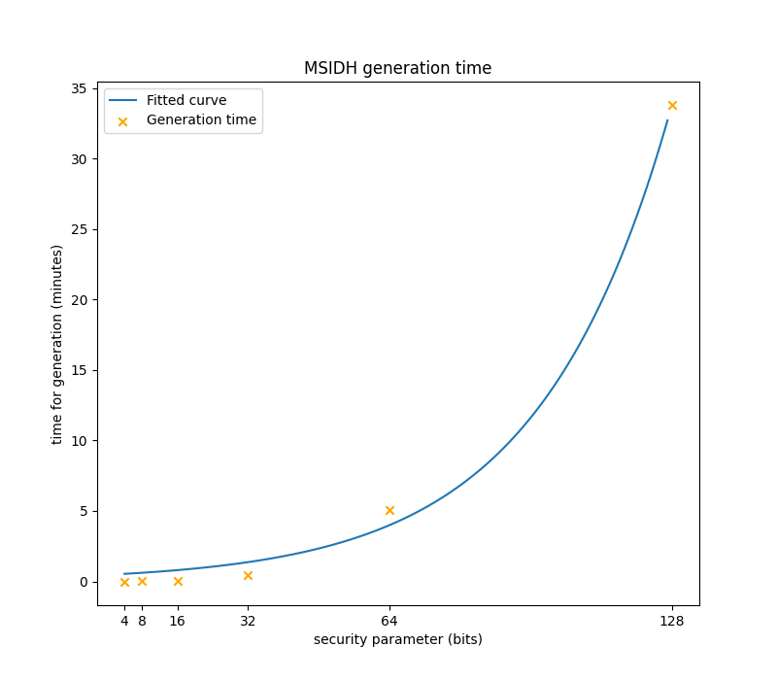
Evaluation of M-SIDH

Slide 17
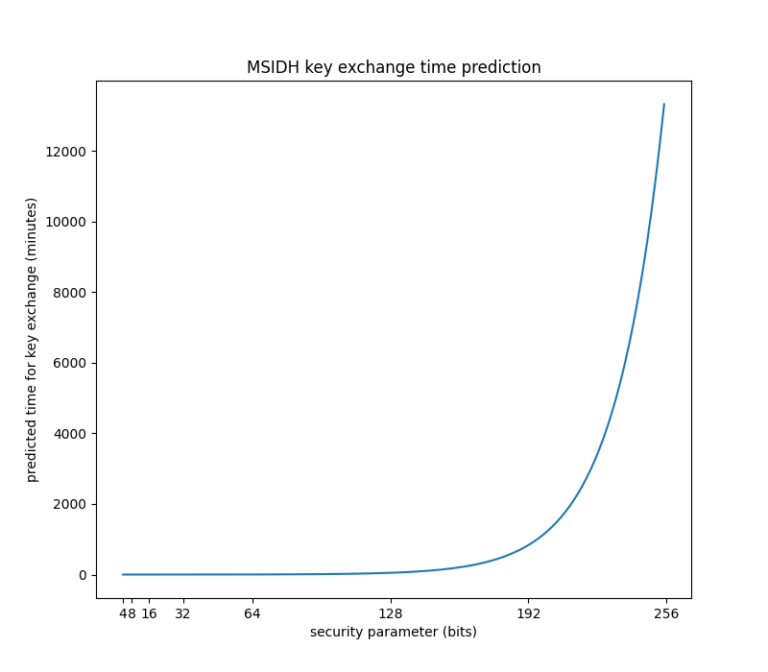
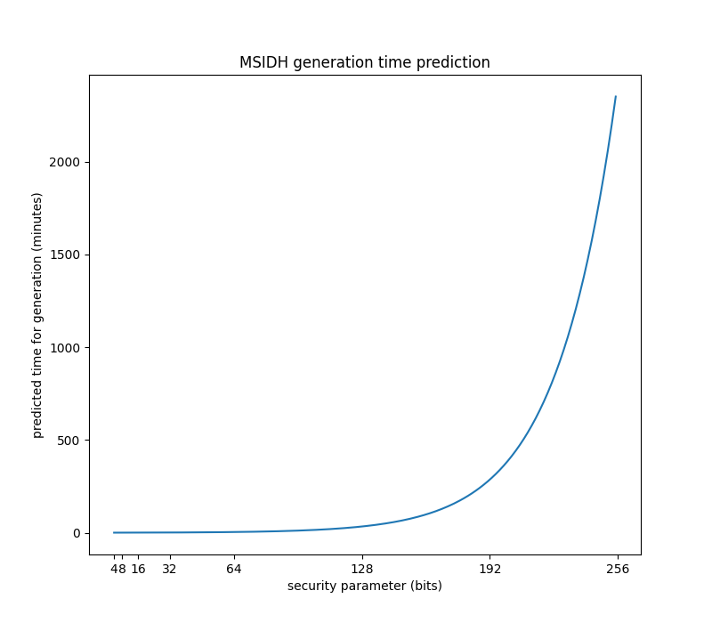
Evaluation of M-SIDH

Slide 18
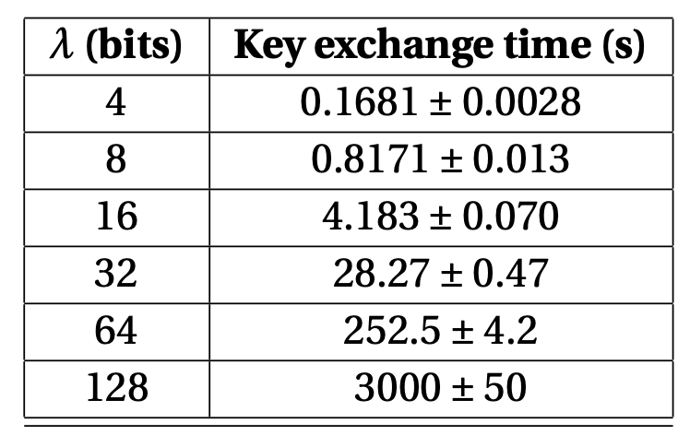
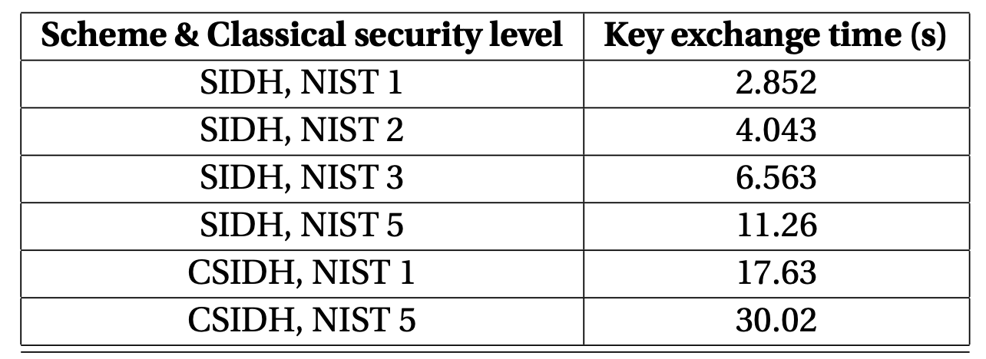
Evaluation of M-SIDH
M-SIDH Implementation results
Reference results (same machine)

Slide 19
Related works
Public key compression in M-SIDH
Kaizhan Lin, Jianming Lin, Shiping Cai, Weize Wang, and Chang-An Zhao
Similar performance (slightly faster)
Uses low-level optimizations (still in Sagemath)
Not generalizable
CSIDH: An Efficient Post-Quantum Commutative Group Action
Wouter Castryck, Tanja Lange, Chloe Martindale, Lorenz Panny, and Joost Renes
Another proposed scheme, not affected by the Castryck & Decru attack
Slightly slower than SIDH, but much better performance than M-SIDH

Slide 20
Conclusion
M-SIDH is currently suffering from performance issues
Main bottleneck is isogeny computation
Next step: Multi-threading, low-level implementation,TPC for curve
Rapidly developing field, but should we rather focus on other alternatives?
Summary of key results

Slide 21
Bibliography
[1] Daniel J. Bernstein, Luca De Feo, Antonin Leroux, and Benjamin Smith. Faster computation of isogenies of large prime degree. Algorithmic Number Theory Symposium 2020, Document ID: 44d5ade1c1778d86a5b035ad20f880c08031a1dc. Homepage: https://velusqrt.isogeny.org/. 2020. U R L: https://velusqrt.isogeny.org/velusqrt-20200616.pdf.
[2] Fabio Campos, Jorge Chavez-Saab, Jesús-Javier Chi-Domínguez, Michael Meyer, Krijn Reijnders, Francisco Rodríguez-Henríquez, Peter Schwabe, and Thom Wiggers. On the Practicality of Post-Quantum TLS Using Large-Parameter CSIDH. Cryptology ePrint Archive, Paper 2023/793. https://eprint.iacr.org/2023/793. 2023. U R L: https://eprint.iacr.org/2023/793.
[3] Wouter Castryck and Thomas Decru. An efficient key recovery attack on SIDH. Cryptology ePrint Archive, Paper 2022/975. 2022. U R L: https://eprint.iacr.org/2022/975.
[4] Wouter Castryck, Tanja Lange, Chloe Martindale, Lorenz Panny, and Joost Renes. CSIDH: An Efficient Post-Quantum Commutative Group Action. Cryptology ePrint Archive, Paper 2018/383. https://eprint.iacr.org/2018/383. 2018. U R L: https://eprint.iacr.org/2018/383.
[5] Craig Costello, Patrick Longa, and Michael Naehrig. Efficient algorithms for supersingular isogeny Diffie-Hellman. Cryptology ePrint Archive, Paper 2016/413. 2016. U R L: https://eprint.iacr.org/2016/413.
[6] Luca De Feo, David Jao, and Jérôme Plût. Towards quantum-resistant cryptosystems from supersingular elliptic curve isogenies. Cryptology ePrint Archive, Paper 2011/506. 2011. U R L: https://eprint.iacr.org/2011/506.
[7] Tako Boris Fouotsa. SIDH with masked torsion point images. Cryptology ePrint Archive, Paper 2022/1054. 2022. U R L: https://eprint.iacr.org/2022/1054.
[8] Tako Boris Fouotsa, Tomoki Moriya, and Christophe Petit. M-SIDH and MD-SIDH: countering SIDH attacks by masking information. Cryptology ePrint Archive, Paper 2023/013. 2023. U R L: https://eprint.iacr.org/2023/013.
[9] Gora Adj, Jesús-Javier Chi-Domínguez, and Francisco Rodríguez-Henríquez. SIBC Python library. 2021. U R L: https://github.com/JJChiDguez/sibc/.
[10] Kaizhan Lin, Jianming Lin, Shiping Cai, Weize Wang, and Chang-An Zhao. Public-key Compression in M-SIDH. Cryptology ePrint Archive, Paper 2023/136. 2023. U R L: https://eprint.iacr.org/2023/136.
[11] University of Duisburg-EssenSVG version: Flugaal Original schema: A.J.jacquie MacLaine/Vinck. File:Diffie-Hellman Key Exchange.svg - Wikimedia Commons. 2020. U R L: https://commons.wikimedia.org/wiki/File:Diffie-Hellman_Key_Exchange.svg.
[12] Damien Robert. Breaking SIDH in polynomial time. Cryptology ePrint Archive, Paper 2022/1038.2022. U R L: https://eprint.iacr.org/2022/1038.
[13] The Sage Developers. SageMath, the Sage Mathematics Software System (Version 9.8). 2023.U R L: https://www.sagemath.org.

Slide 22
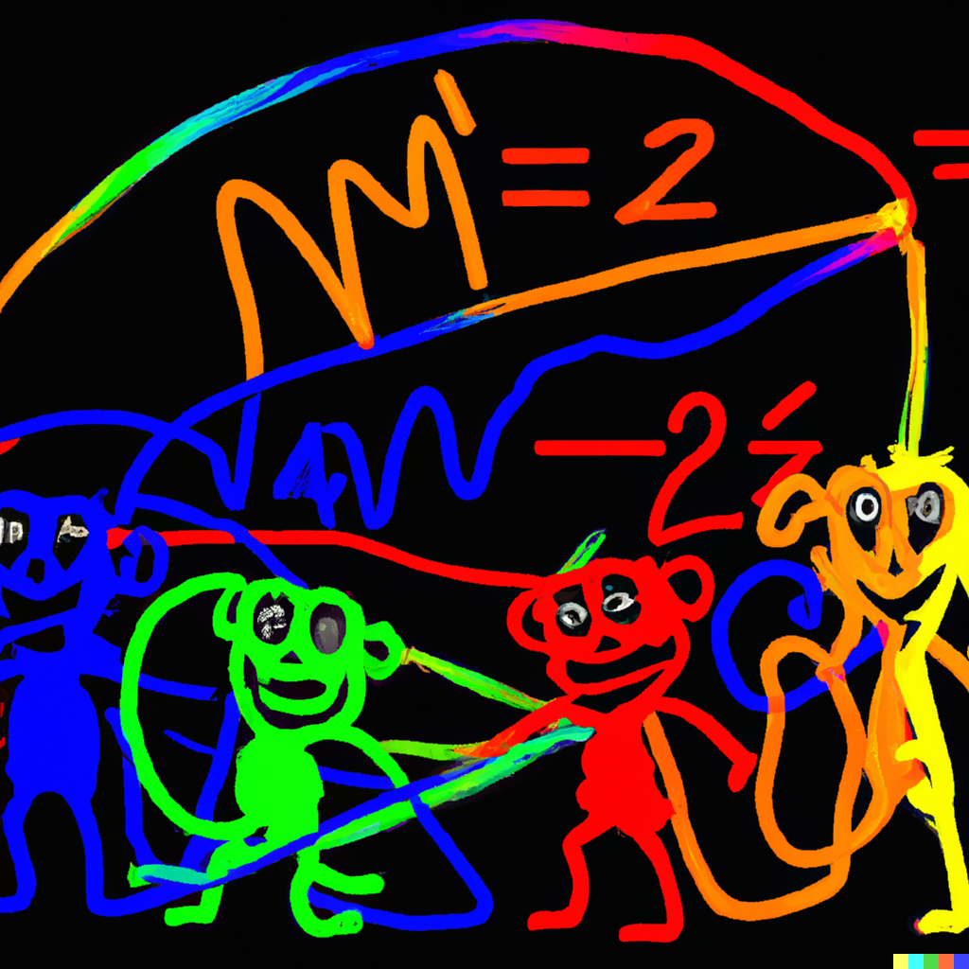
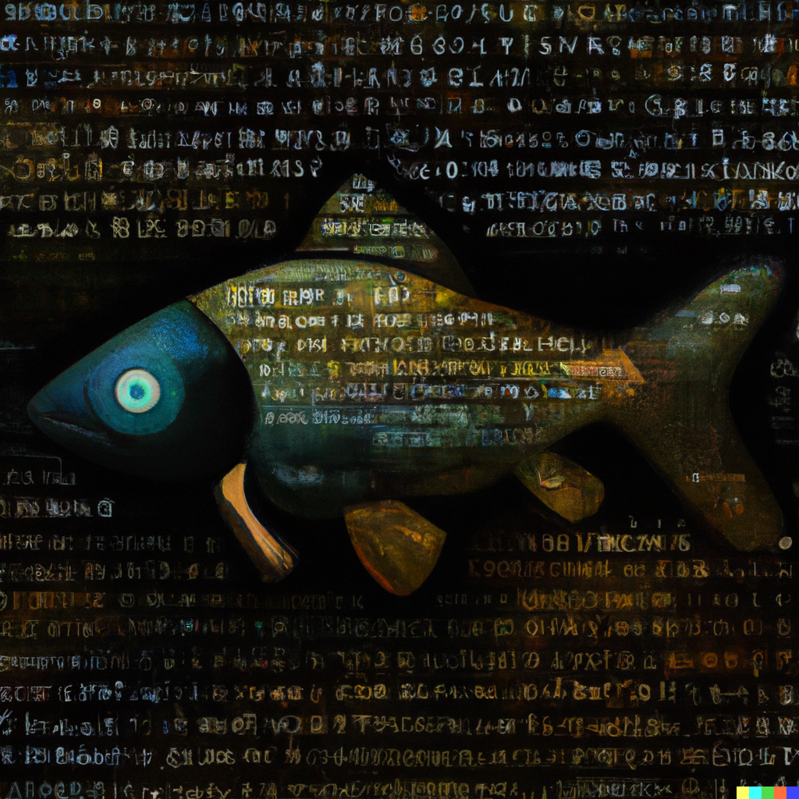
Questions?
Monkeys doing Elliptic Curve Cryptography
Cryptographic fish (Rembrandt)
Fig.4: Generated illustrations [DALL-E-2]

